Slide 1
Data 2 - Trees Design Programming 2

Slide 2
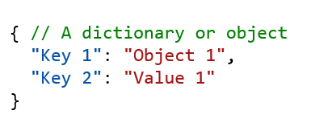
Python / General Web data (Javascript, JSON, etc)
Dictionaries
Arrays
[ # An Array
“Item 1",
“Item 2",
3,
Object_1
]
Or
[ “Item 1", “Item 2", 3, Object_1]

Slide 3
Python / General Web data (Javascript, JSON, etc)
Dictionaries & arrays
[ // An Array
{
"Key 1": "Object 1",
"Key 2": "Value 1"
},
{
"Key 1": "Object 2",
},
{
"Key 2": "Value 3",
"Key 1": "Object 3",
"Key 3": "Value 4" // Flexible
}
]

Slide 4
Python / General Web data (Javascript, JSON, etc)
Nested objects
[ // An Array
{
"Key 1": “Value 1",
"Key 2": "Value 2"
},
{
"Key 2": "Value 3",
"Key 1": “Value 4",
"Key 3": {
"Key 3a": “Value 1",
"Key 3b": “Value 2",
}
}
]

Slide 5
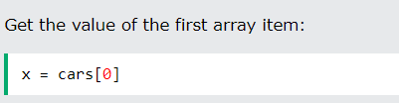


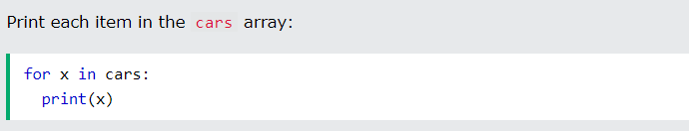
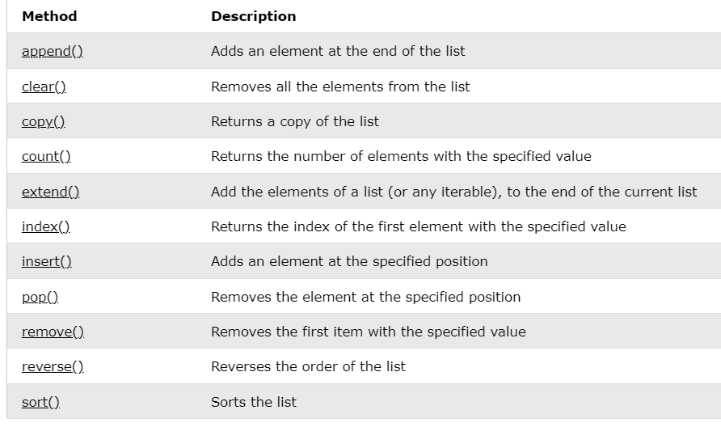
Accessing arrays (see w3c Python Arrays)

Slide 6
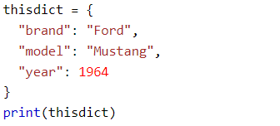



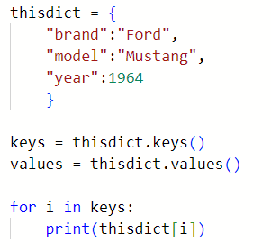

Dictionaries (see W3c Python Dictionaries)
Creating
Creating – using dict()
Accessing individual items
Accessing all items

Slide 7
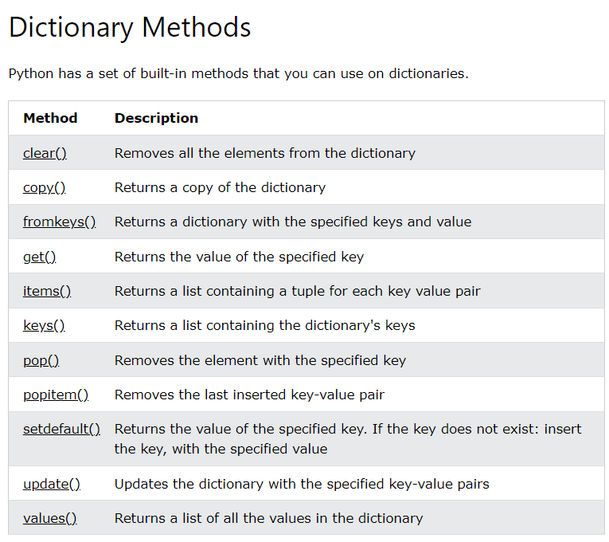
Dictionaries (see W3c Python Dictionaries)

Slide 8
“Structured” vs “Unstructured” Data
Sometimes data associated with instances is consistent across similar instances. This sort of data is (somewhat erroneously) called “structured data” or “tabular data”, and we can represent it in a table, where
- Rows are individual data instances
- columns are the different (but consistent) key – value combinations:
Sometimes a specific parameter is identified as the ID of the instance. In that case this value must be unique for each instance:
ID | brand | model | year
00001 | Ford | Mustang | 1964
00002 | Ford | Mustang | 1967
00003 | BMW | I5 | 2022
00004 | BMW | I3 | 2024
00005 | Volkswagen | Rabbit | 1990
This is equivalent to - but not the same as - the following
[
{
ID : 00001,
brand: “Ford”,
model: “Mustang”,
year: 1964
},
{
ID : 00002,
brand: “Ford”,
model: “Mustang”,
year: 1967
},
. . .

Slide 9
Tabular data - serialization
Tabular data can be “serialized” as text with defined character separators between fields.
Serialize (roughly) write data out to a string or stream
This example:
ID | brand | model | year
00001 | Ford | Mustang | 1964
00003 | BMW | I5 | 2022
00005 | Volkswagen | Rabbit | 1990
Could be serialized as follows:
ID,brand,model,year <cr>
00001,Ford,Mustang,1964 <cr>
00003,BMW,I5,2022 <cr>
00005,Volkswagen,Rabbit,1990 <cr>
This serialization has commas between fields and is known as CSV (comma separated value) format.

Slide 10
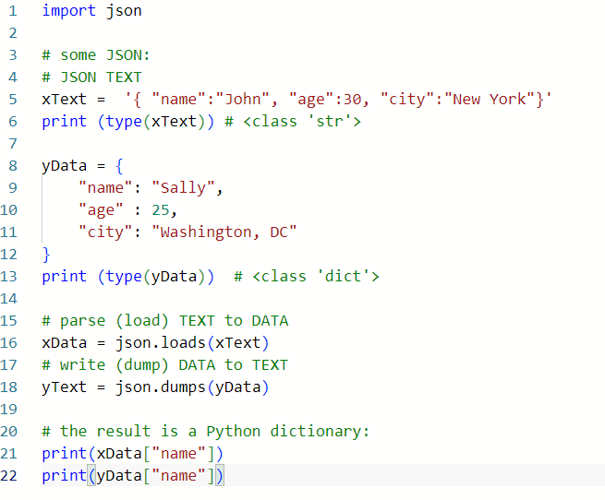
Data serialization: to JSON
json.loads(“aString”)
json.dumps(anObject)

Slide 11
Data vs. Objects
Data is naturally organized in name / value or key / value pairs:
Key Value
var1 “My text”
var2 “My other value”
A collection of name / value pairs is sometimes called a dictionary. It’s a very powerful and general concept so you will see either “analogies” of this concept in other contexts, or in fact actual reframing of the concept in other contexts.
For example, an object instance shares a lot with this dictionary concept, and objects and dictionaries are sometimes (not always) used interchangeably.
thisdict = { "brand": "Ford", "model": "Mustang", "year": 1964 }
class Car: def __init__(brand, model, year): self.brand = brand self.model = model
self.year = year
c1 = Car(“Ford”, “Mustang”, 1964)
c1.brand = “Ford”
c1.model = “Mustang”
c1.year = 1964

Slide 12
Dictionaries (see W3c Python Dictionaries)
Creating
Creating – using dict()
Accessing individual items
Accessing all items

Slide 13
Copy vs. Deep copy
data1
{
"value1": "car",
"value2": "ford",
"value3": 1964,
}
data2
{
"value1": "car",
"value2": "ford",
"value3": 1964,
}
data1
x000000
data2
x000000
"value1" | "car"
"value2" | "ford"
"value3" | 1964

Slide 14
Dictionaries (see W3c Python Dictionaries)

Slide 15
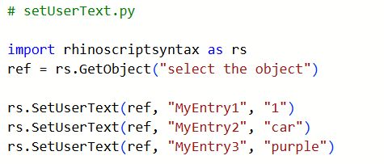
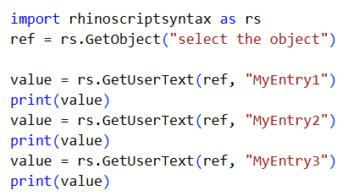
Object Data
Similarly, data can be saved on specific objects using SetUserText and related functions,
and can be retrieved using GetUserText.
This data is persistent on the object, so it can be retrieved after the file is saved and re-opened later.

Slide 16
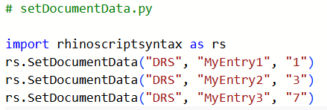
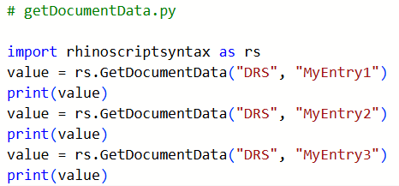
Document Data
Data can be saved to the document using SetDocumentData and related functions,
and can be retrieved using GetDocumentData.
This data is persistent on the file, so it can be retrieved after the file is saved and re-opened later.

Slide 17
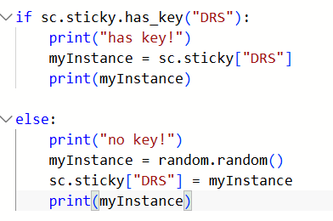
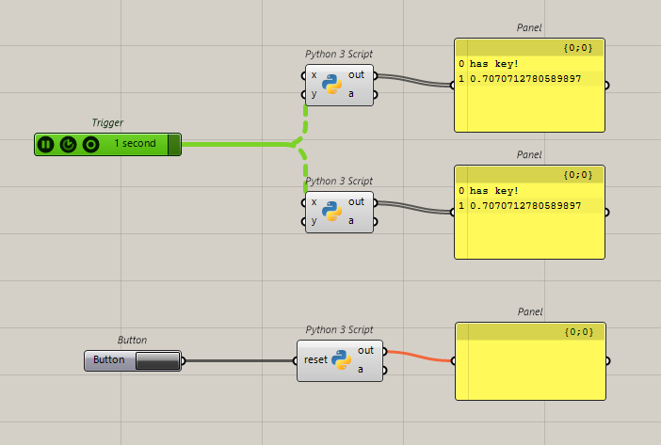
The “sticky dictionary”
In the context of Rhino and Grasshopper scripting, scriptcontext.sticky is a built-in, standard Python dictionary that persists during a Rhino session, allowing you to store and retrieve data between different scripts and even different components.

Slide 18
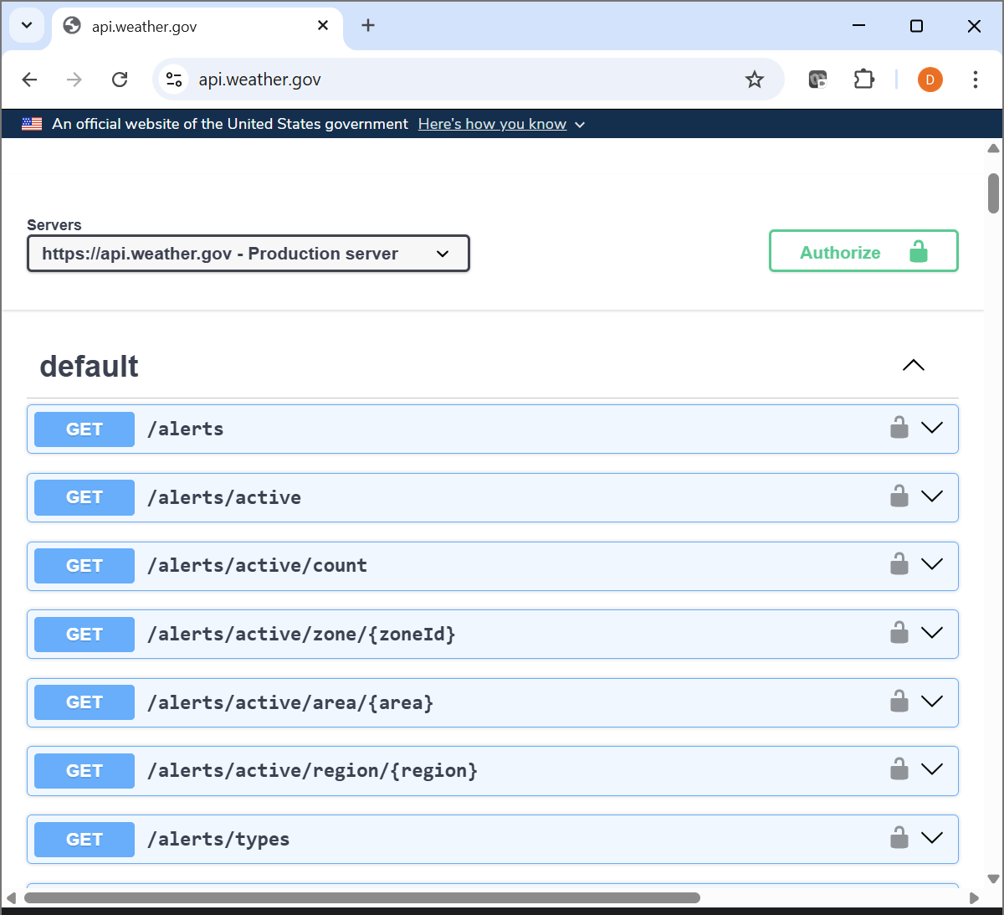
Getting data from the Web example: weather data

Slide 19
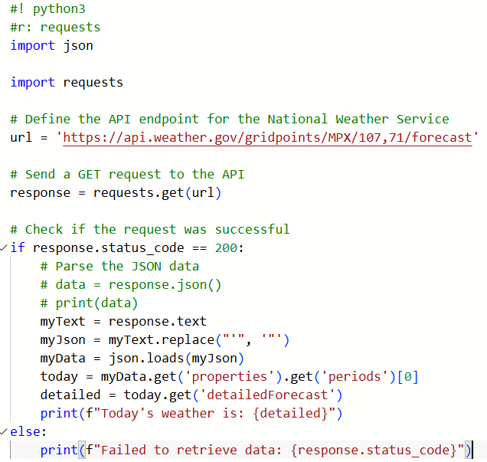

Getting data from the Web getWeather.py
Lots of data is available from the web using “REST APIs”. These often return data in JSON format.

Slide 20
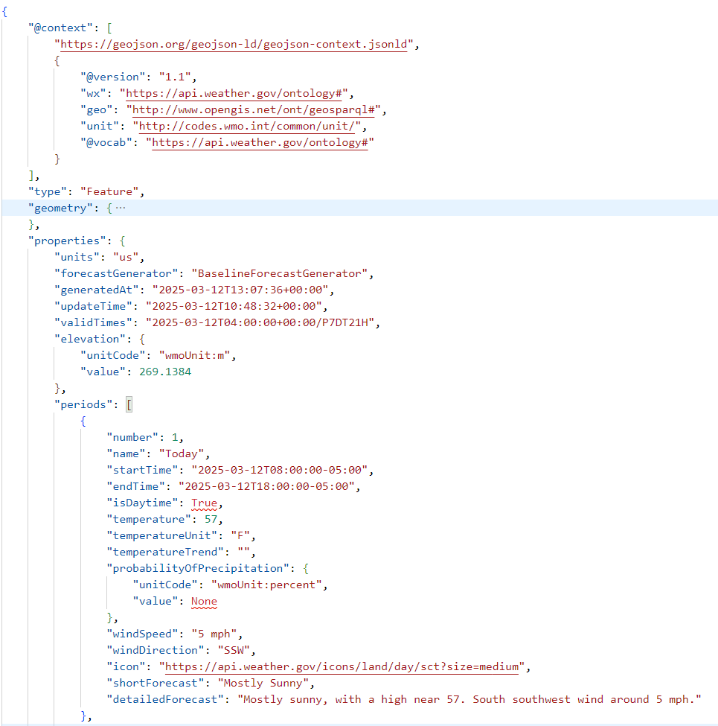
Getting data from the Web getWeather.py
Lots of data is available from the web using “REST APIs”. These often return data in JSON format.

Slide 21
Assignment this week
Develop one or more data structures to manage the object data for your project.
Read and write this data to a file, using both
Structured / tabular data (save as .XLS or CSV)
Unstructured (JSON) data

